Slide 1
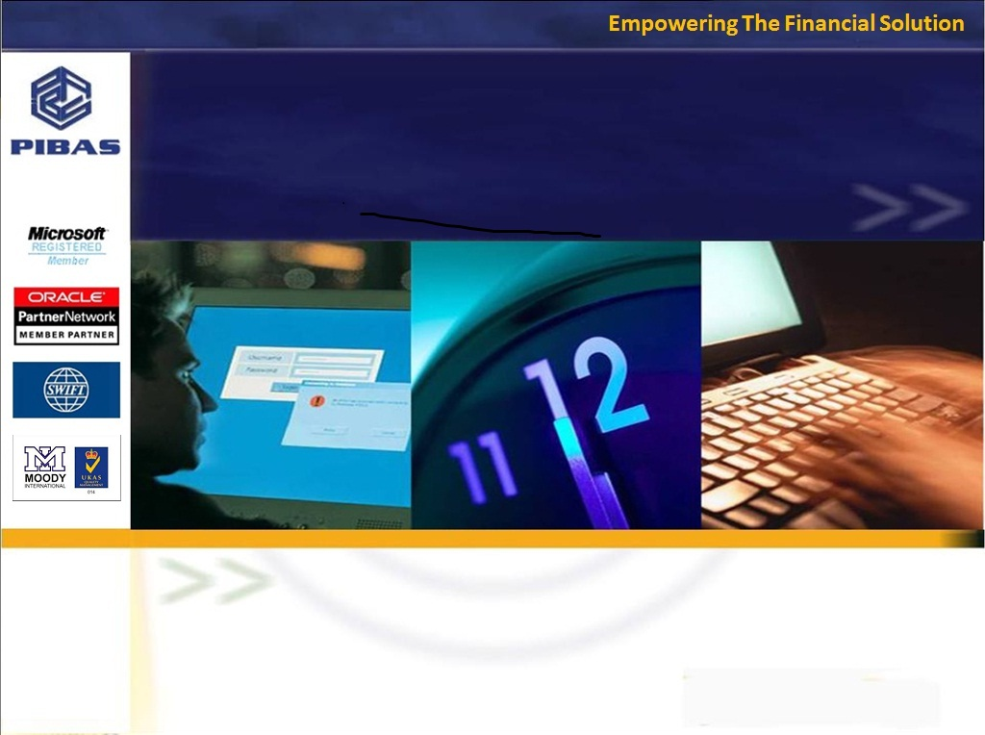
Product Knowledge Training Session PIBAS Products - Clearing (outward)
Presented By PIBAS Support Team

Slide 2
Contents
Clearing
Outward Clearing Posting
Marking Dis-Honour
Clearing Supervision
Today’s Clearing Release
Today’s Clearing Schedule
Today’s Clearing Inquiry
Dis-Honoured Cheques Report

Slide 3
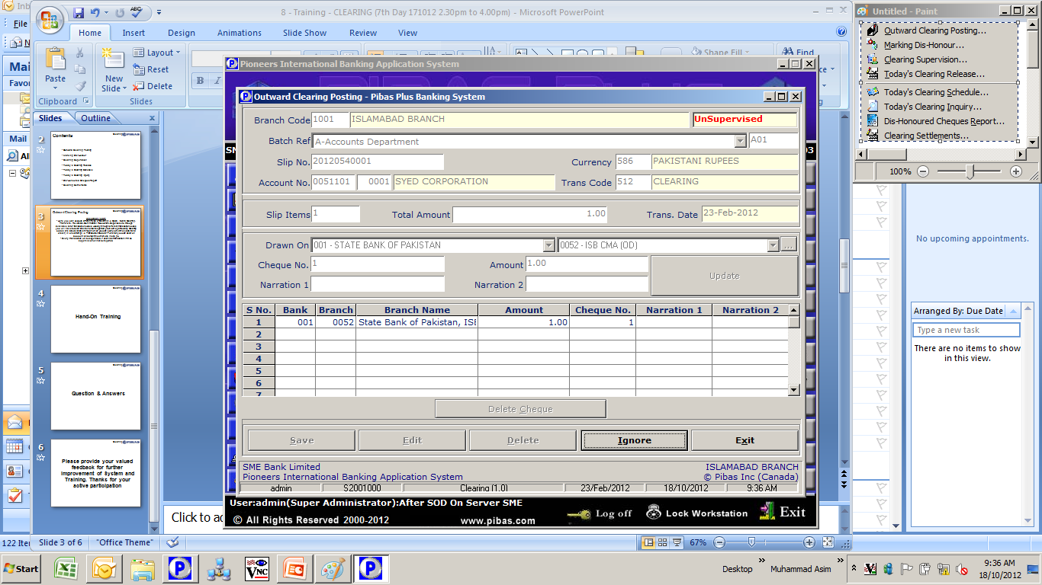
Outward Clearing Posting
Clearing
Important Points
In this module, cheques are deposited into customer accounts that are processed by Central Bank or any depute Government or Non-Government institution for onward credit to customer accounts within two to three days (may vary as per local banking rules)
Here more than one cheques could be posted that are deposited by customer in one slip
Correct input of Bank and its Branch is also important

Slide 4
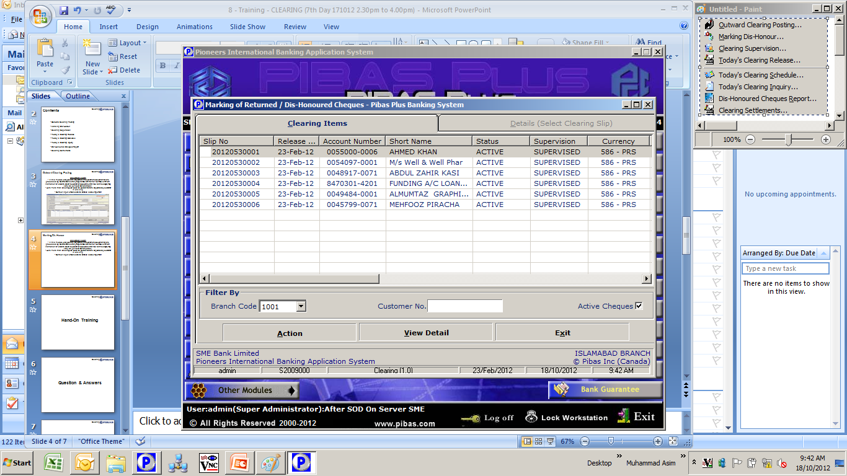
Marking Dis-Honour
Clearing
Important Points
This option is used for marking Dis-Honour / return any cheque due to any reason, these are the cheque that were lodged / posted previous day.
These dis-honoured cheques have be supervised as well.

Slide 5
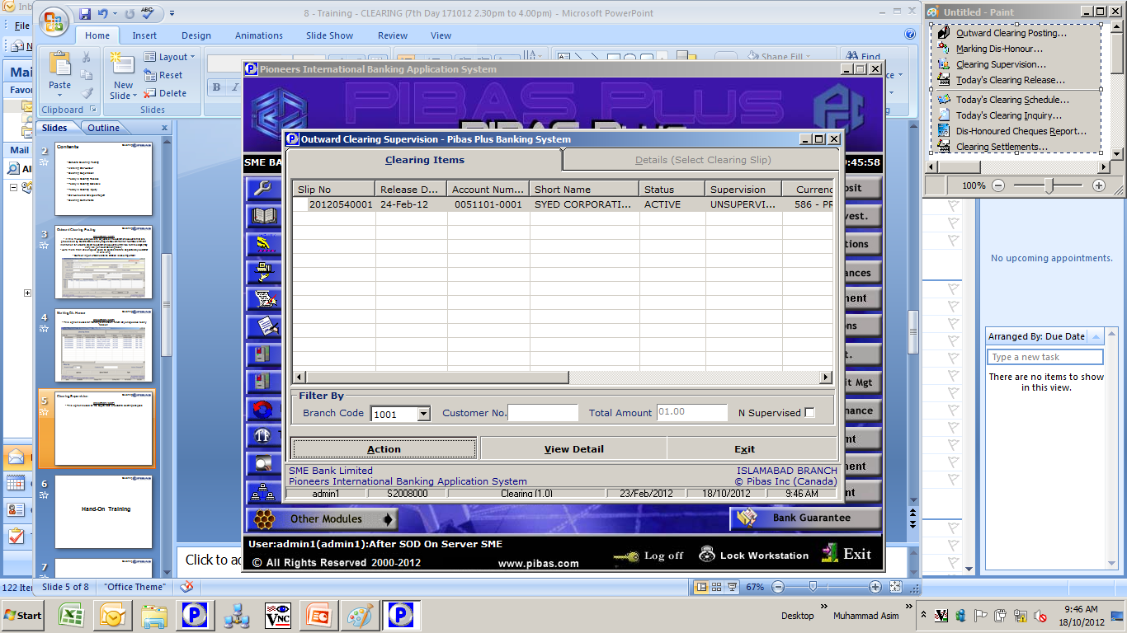
Clearing Supervision
Clearing
Important Points
This option is used for the supervision and cancellation of outward clearing cheques posting (s)

Slide 6
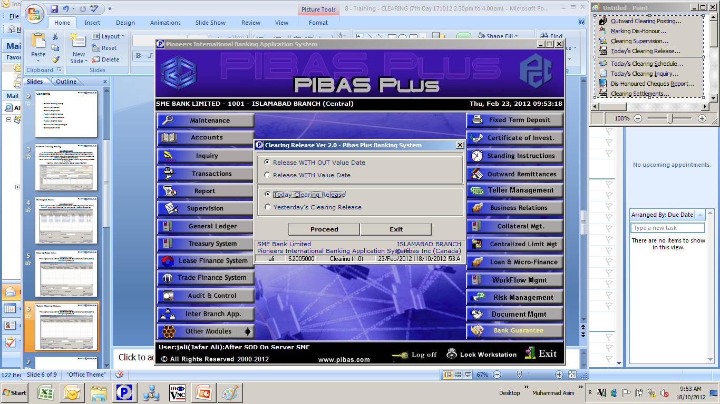
Today’s Clearing Release
Clearing
Important Points
This option is used to release the cheques amounts into customer accounts that were lodged in previous day’s clearing posting. In other words it updates the balances as well.
Here you can also use Yesterday’s Clearing Release option, in case you have forgot to execute this option yesterday, due to holiday or due to any other reason / policy.

Slide 7
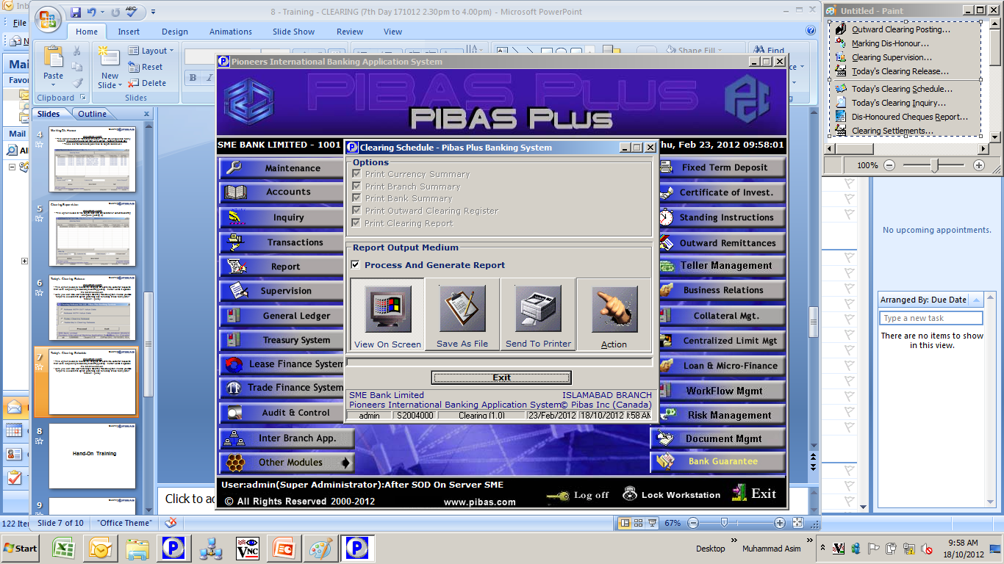
Today’s Clearing Schedule
Clearing
Important Points
This report option provides the information of today’s clearing lodgment / posting

Slide 8
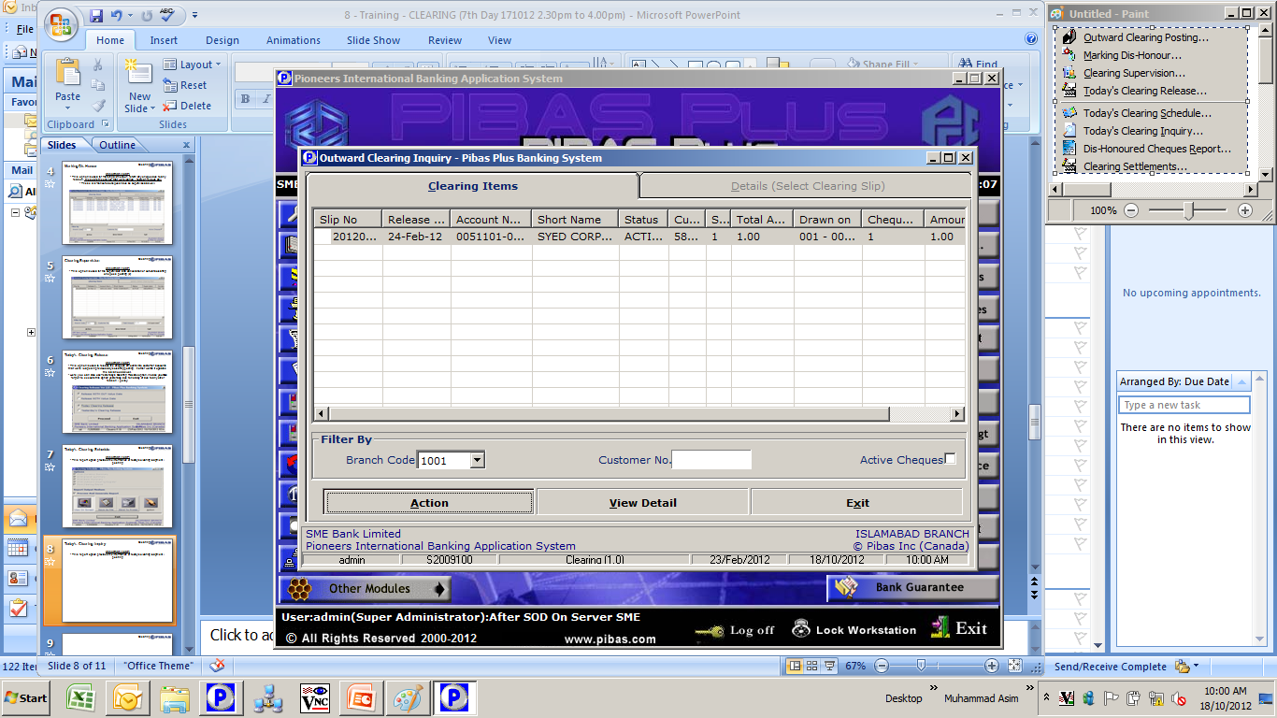
Today’s Clearing Inquiry
Clearing
Important Points
This report option provides the information of today’s clearing lodgment / posting on screen

Slide 9
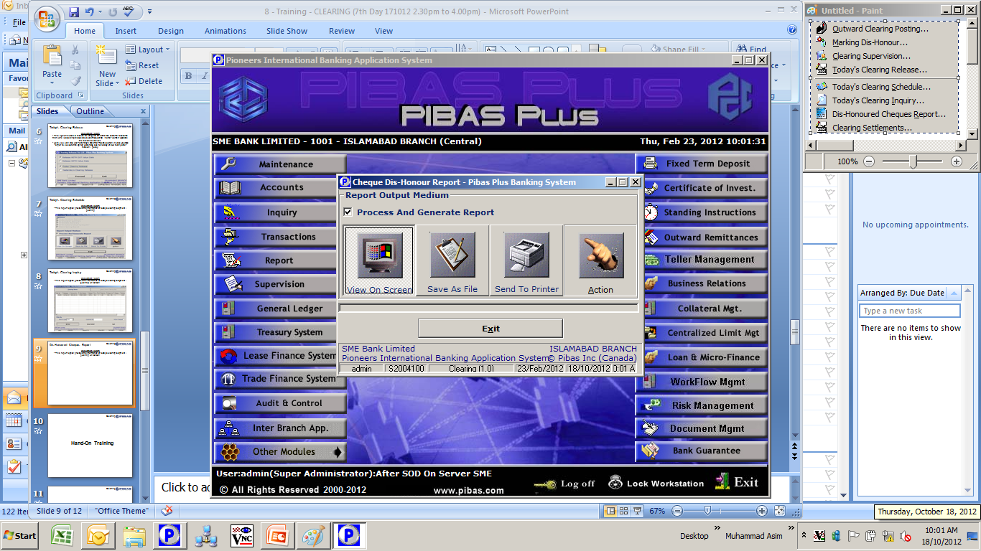
Dis-Honoured Cheques Report
Clearing
Important Points
This report option provides the information of dis-honoured cheques

Slide 10
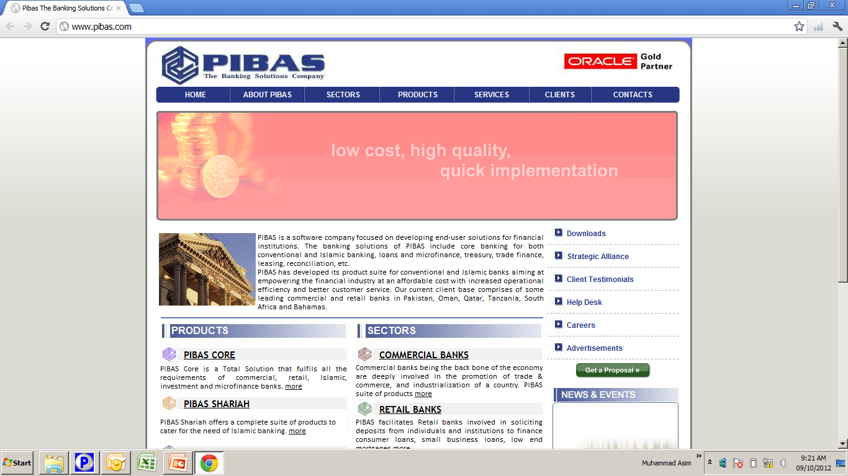
Clearing
Many thanks for your active participation

